Slide 1
Unit 15 K-Means Clustering Algorithm
Machine Learning

Slide 2
K-Means Clustering Algorithm
K-Means Clustering is an unsupervised learning algorithm that is used to solve the clustering problems in machine learning or data science.
In this topic, we will learn
  what is K-means clustering algorithm,
  how the algorithm works,
  along with the Python implementation of k-means clustering.

Slide 3
What is K-Means Algorithm?
K-Means Clustering is an Unsupervised Learning algorithm, which groups the unlabeled dataset into different clusters.
Here K defines the number of pre-defined clusters that need to be created in the process, as if K=2, there will be two clusters, and for K=3, there will be three clusters, and so on.

Slide 4
What is K-Means Algorithm?
It is an iterative algorithm that divides the unlabeled dataset into k different clusters in such a way that each dataset belongs only one group that has similar properties.
It allows us to cluster the data into different groups and a convenient way to discover the categories of groups in the unlabeled dataset on its own without the need for any training.

Slide 5
What is K-Means Algorithm?
It is a centroid-based algorithm, where each cluster is associated with a centroid.
The main aim of this algorithm is to minimize the sum of distances between the data point and their corresponding clusters.
The algorithm takes the unlabeled dataset as input, divides the dataset into k-number of clusters, and repeats the process until it does not find the best clusters.

Slide 6
What is K-Means Algorithm?
The value of k should be predetermined in this algorithm.
The k-means clustering algorithm mainly performs two tasks:
  Determines the best value for K center points or centroids by an iterative process.
  Assigns each data point to its closest k-center. Those data points which are near to the particular k-center, create a cluster.

Slide 7
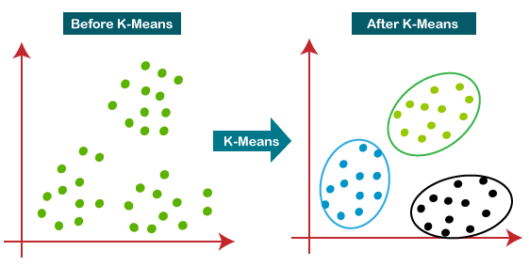
What is K-Means Algorithm?
Hence each cluster has datapoints with some commonalities, and it is away from other clusters.
The below diagram explains the working of the K-means Clustering Algorithm:

Slide 8
How does the K-Means Algorithm Work?
The working of the K-Means algorithm is explained in the below steps:
  Step-1: Select the number K to decide the number of clusters.
  Step-2: Select random K points or centroids. (It can be other from the input dataset).
  Step-3: Assign each data point to their closest centroid, which will form the predefined K clusters.

Slide 9
How does the K-Means Algorithm Work?
The working of the K-Means algorithm:
  Step-4: Calculate the variance and place a new centroid of each cluster.
  Step-5: Repeat the third steps, which means reassign each datapoint to the new closest centroid of each cluster.
  Step-6: If any reassignment occurs, then go to step-4 else go to FINISH.
  Step-7: The model is ready.

Slide 10
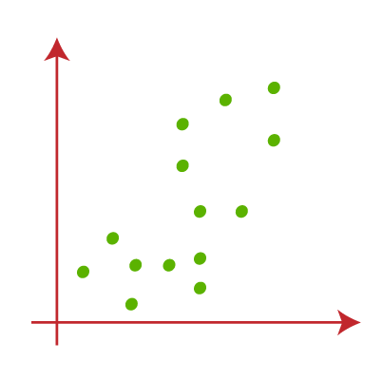
How does the K-Means Algorithm Work?
Suppose we have two variables M1 and M2. The x-y axis scatter plot of these two variables is given below:

Slide 11
How does the K-Means Algorithm Work?
Let's take number k of clusters, i.e., K=2, to identify the dataset and to put them into different clusters.
It means here we will try to group these datasets into two different clusters.
We need to choose some random k points or centroid to form the cluster.
These points can be either the points from the dataset or any other point.

Slide 12
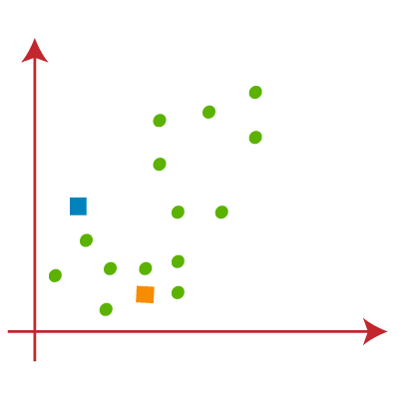
How does the K-Means Algorithm Work?
So, here we are selecting the below two points as k points, which are not the part of our dataset. Consider the below image:

Slide 13
How does the K-Means Algorithm Work?
Now we will assign each data point of the scatter plot to its closest K-point or centroid.
We will compute it by applying some mathematics that we have studied to calculate the distance between two points.
So, we will draw a median between both the centroids.

Slide 14
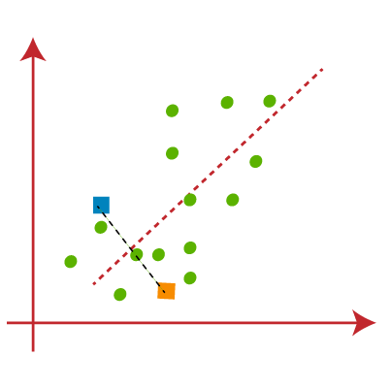
How does the K-Means Algorithm Work?
It is clear that points left side of the line is near to the K1 or blue centroid, and points to the right of the line are close to the yellow centroid.

Slide 15
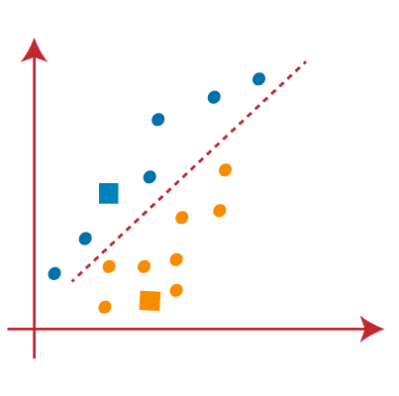
How does the K-Means Algorithm Work?
Let's color them as blue and yellow for clear visualization.

Slide 16
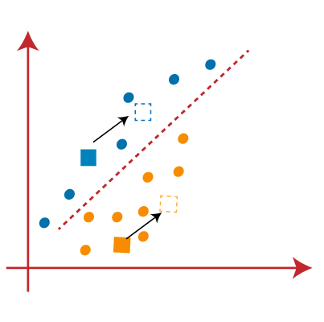
How does the K-Means Algorithm Work?
As we need to find the closest cluster, so we will repeat the process by choosing a new centroid.
To choose the new centroids, we will compute the center of gravity of these centroids, and will find new centroids:

Slide 17
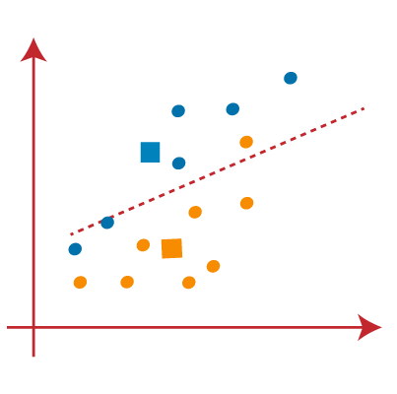
How does the K-Means Algorithm Work?
Next, we will reassign each datapoint to the new centroid.
For this, we will repeat the same process of finding a median line. The median will be like below image:

Slide 18
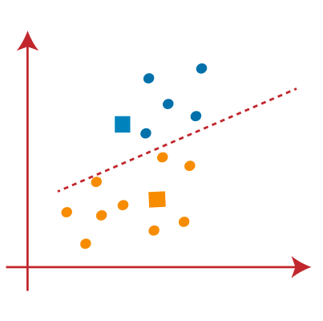
How does the K-Means Algorithm Work?
From the above image, we can see, one yellow point is on the left side of the line, and two blue points are right to the line.
So, these three points will be assigned to new centroids.

Slide 19
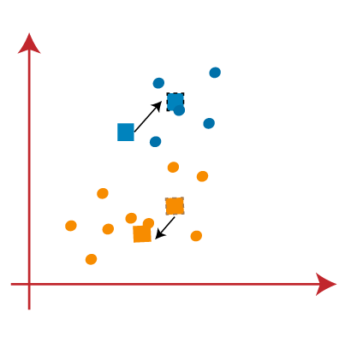
How does the K-Means Algorithm Work?
As reassignment has taken place, so we will again go to the step-4, which is finding new centroids or K-points.
We will repeat the process by finding the center of gravity of centroids, so the new centroids will be as shown in the below image:

Slide 20
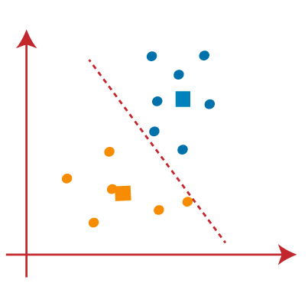
How does the K-Means Algorithm Work?
As we got the new centroids so again will draw the median line and reassign the data points. So, the image will be:

Slide 21
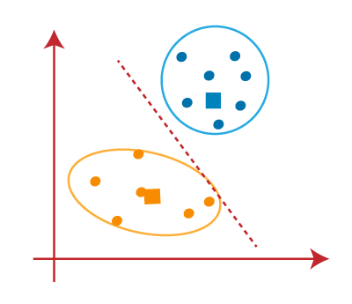
How does the K-Means Algorithm Work?
We can see in the above image; there are no dissimilar data points on either side of the line, which means our model is formed. Consider the below image:

Slide 22

How does the K-Means Algorithm Work?
As our model is ready, so we can now remove the assumed centroids, and the two final clusters will be as shown in the below image:

Slide 23
How to choose the value of "K number of clusters" in K-means Clustering?
The performance of the K-means clustering algorithm depends upon highly efficient clusters that it forms.
But choosing the optimal number of clusters is a big task.
There are some different ways to find the optimal number of clusters, but here we are discussing the most appropriate method to find the number of clusters or value of K.

Slide 24
How to choose the value of "K number of clusters" in K-means Clustering?
Elbow Method
  The Elbow method is one of the most popular ways to find the optimal number of clusters.
  This method uses the concept of WCSS value.
  WCSS stands for Within Cluster Sum of Squares, which defines the total variations within a cluster.

Slide 25
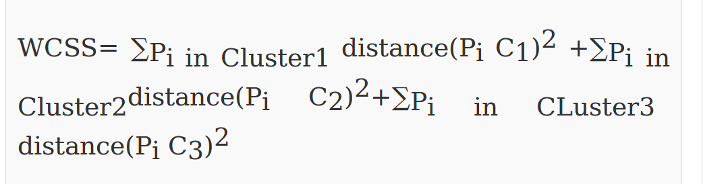
How to choose the value of "K number of clusters" in K-means Clustering?
Elbow Method
  The formula to calculate the value of WCSS (for 3 clusters) is given below:

Slide 26
How to choose the value of "K number of clusters" in K-means Clustering?
Elbow Method
  ∑Pi in Cluster1 distance(Pi C1)2:
  It is the sum of the square of the distances between each data point and its centroid within a cluster1 and the same for the other two terms.

Slide 27
How to choose the value of "K number of clusters" in K-means Clustering?
Elbow Method
  To measure the distance between data points and centroid, we can use any method such as Euclidean distance or Manhattan distance.
  To find the optimal value of clusters, the elbow method follows the below steps:
    It executes the K-means clustering on a given dataset for different K values (ranges from 1-10).

Slide 28
How to choose the value of "K number of clusters" in K-means Clustering?
Elbow Method
    For each value of K, calculates the WCSS value.
    Plots a curve between calculated WCSS values and the number of clusters K.
    The sharp point of bend or a point of the plot looks like an arm, then that point is considered as the best value of K.

Slide 29
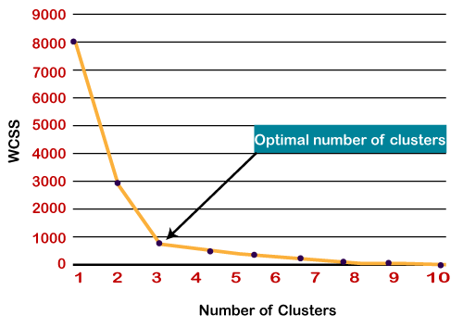
How to choose the value of "K number of clusters" in K-means Clustering?
Elbow Method
  Since the graph shows the sharp bend, which looks like an elbow, hence it is known as the elbow method.
  The graph for the elbow method looks like the below image:

Slide 30
How to choose the value of "K number of clusters" in K-means Clustering?
Elbow Method
  Note: We can choose the number of clusters equal to the given data points.
  If we choose the number of clusters equal to the data points, then the value of WCSS becomes zero, and that will be the endpoint of the plot.

Slide 31
Python Implementation of K-means Clustering Algorithm
In the above section, we have discussed the K-means algorithm, now let's see how it can be implemented using Python.
Before implementation, let's understand what type of problem we will solve here.
So, we have a dataset of Mall_Customers, which is the data of customers who visit the mall and spend there.

Slide 32
Python Implementation of K-means Clustering Algorithm
In the given dataset, we have Customer_Id, Gender, Age, Annual Income ($), and Spending Score (which is the calculated value of how much a customer has spent in the mall, the more the value, the more he has spent).
From this dataset, we need to calculate some patterns, as it is an unsupervised method, so we don't know what to calculate exactly.

Slide 33
Python Implementation of K-means Clustering Algorithm
The steps to be followed for the implementation are given below:
  Data Pre-processing
  Finding the optimal number of clusters using the elbow method
  Training the K-means algorithm on the training dataset
  Visualizing the clusters

Slide 34
Python Implementation of K-means Clustering Algorithm
Step-1: Data pre-processing Step
  The first step will be the data pre-processing, as we did in our earlier topics of Regression and Classification.
  But for the clustering problem, it will be different from other models. Let's discuss it:

Slide 35
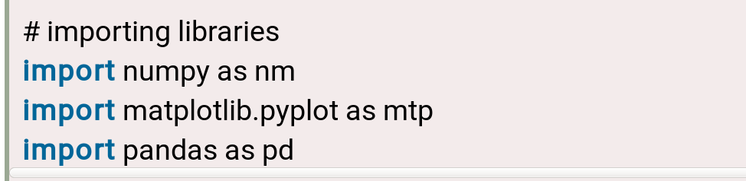
Python Implementation of K-means Clustering Algorithm
Importing Libraries
  As we did in previous topics, firstly, we will import the libraries for our model, which is part of data pre-processing.
  The code is given below:

Slide 36
Python Implementation of K-means Clustering Algorithm
Importing Libraries
  The numpy we have imported for the performing mathematics calculation, matplotlib is for plotting the graph, and pandas are for managing the dataset.

Slide 37
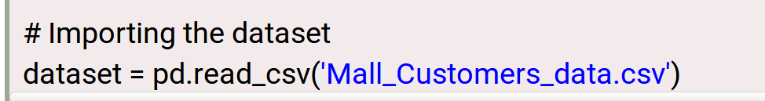
Python Implementation of K-means Clustering Algorithm
Importing the Dataset:
  Next, we will import the dataset that we need to use.
  So here, we are using the Mall_Customer_data.csv dataset.
  It can be imported using the below code:
https://www.javatpoint.com/k-means-clustering-algorithm-in-machine-learning

